Slide 2


Slide 3
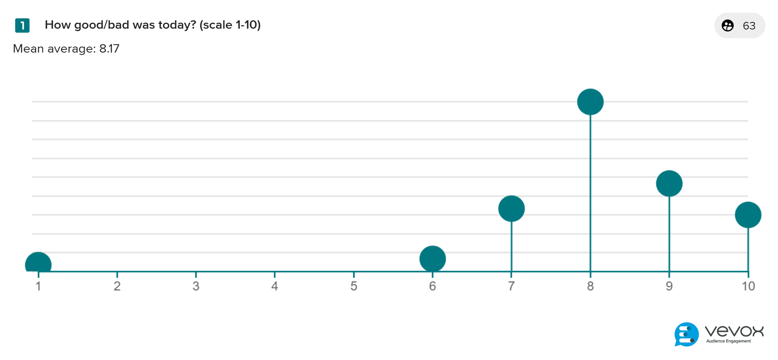
Feedback & Follow-up

Slide 4
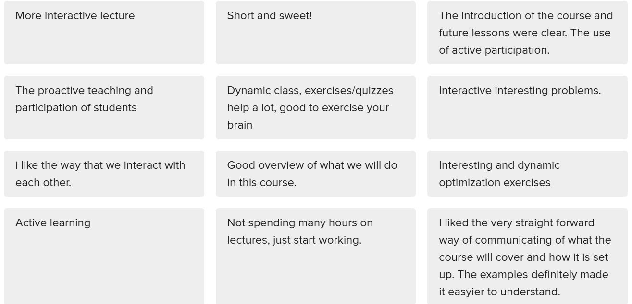
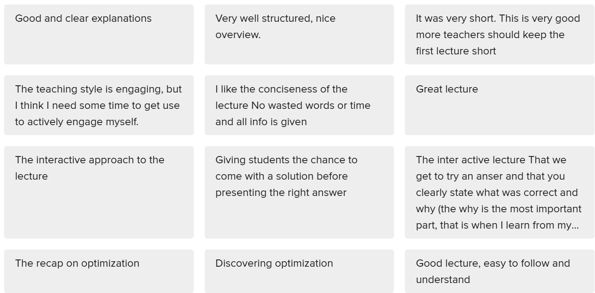
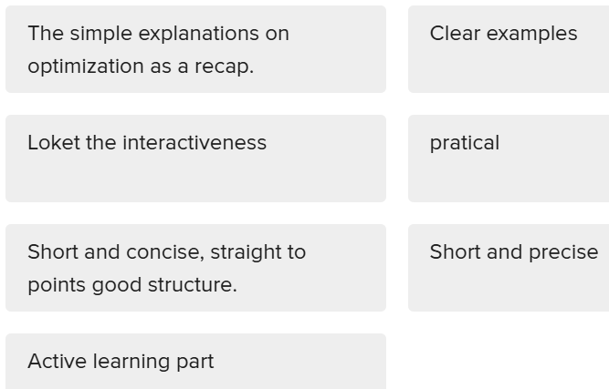
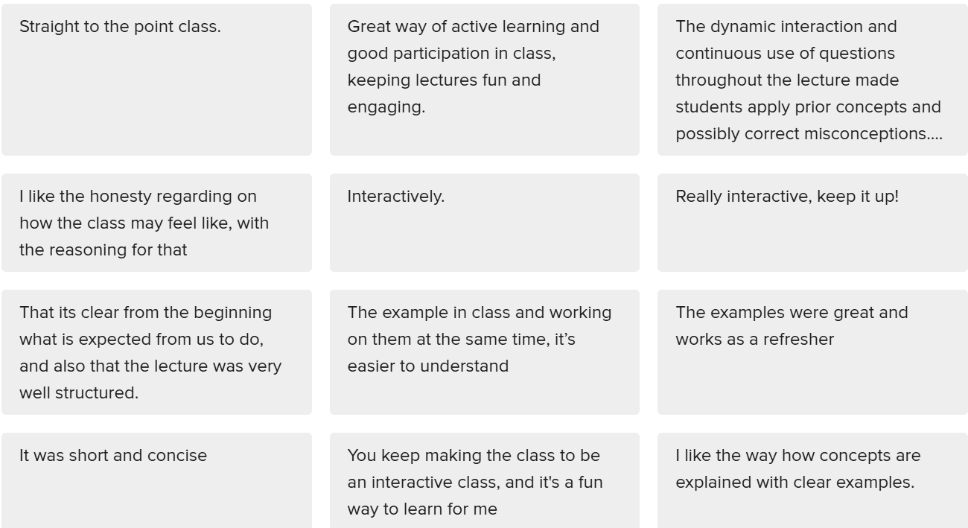
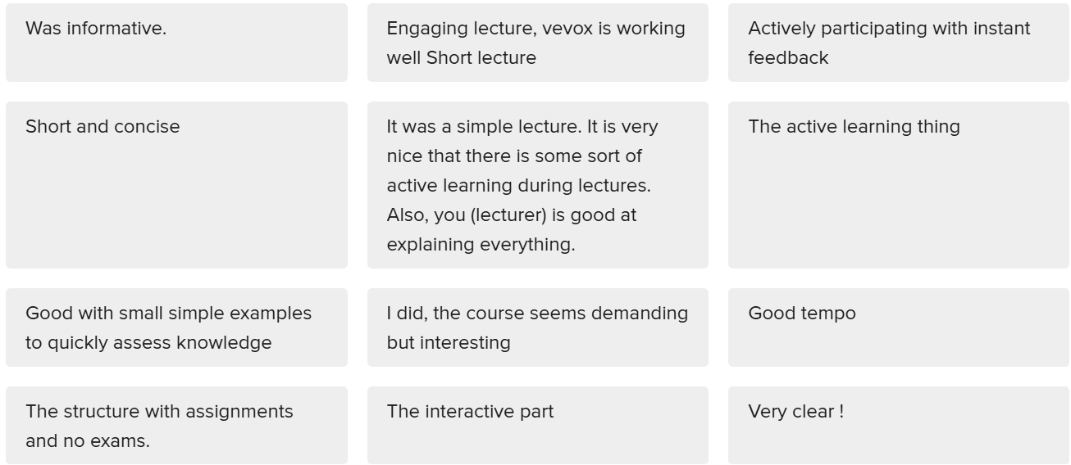
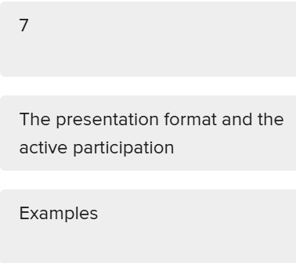
What you liked

Slide 5
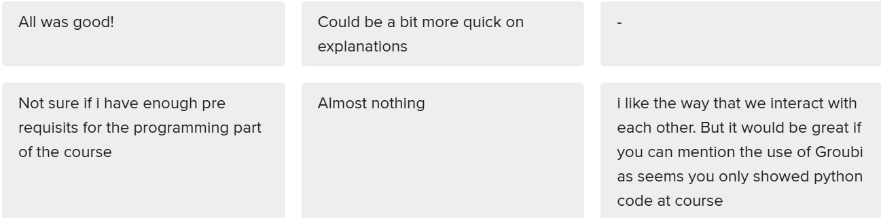
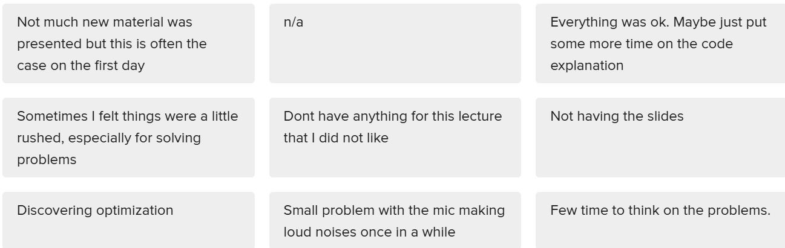
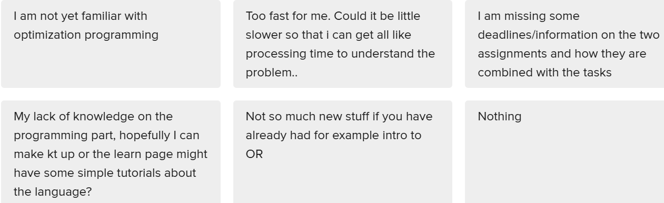
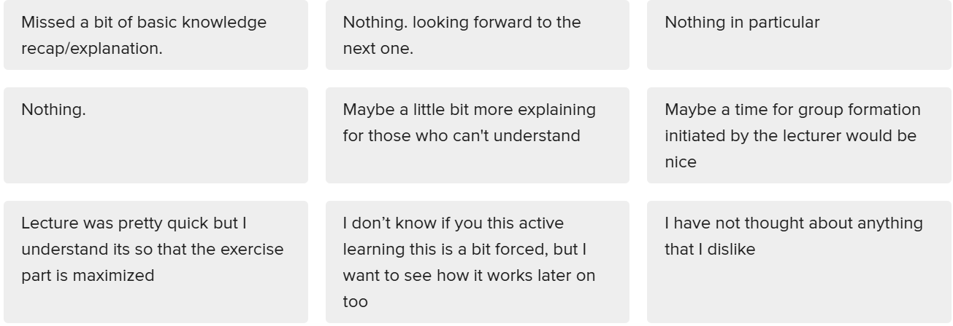
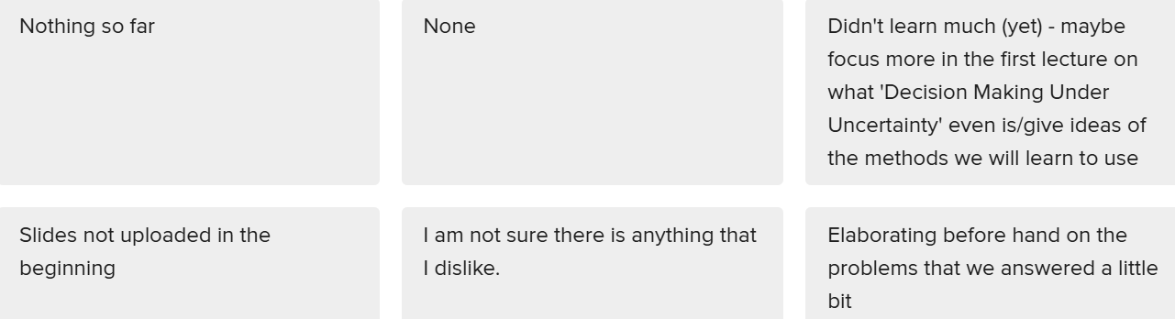
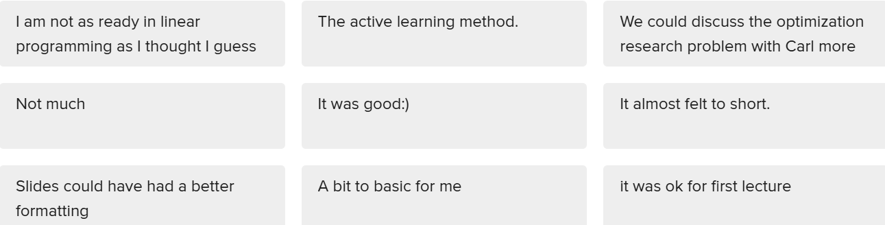
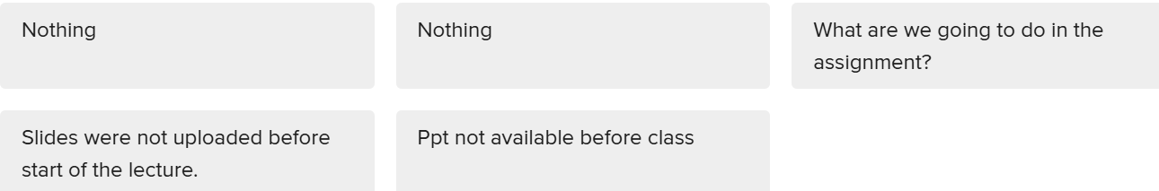
What you disliked

Slide 6
What you disliked

Slide 7
What you disliked

Slide 8
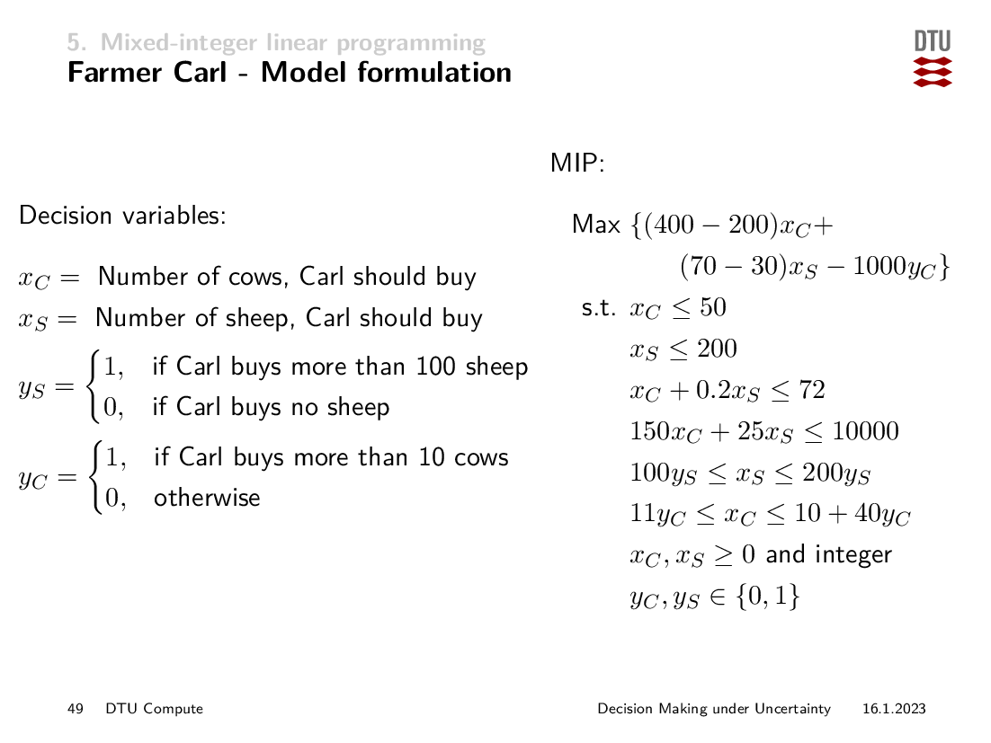
Sanity Check!

Slide 9
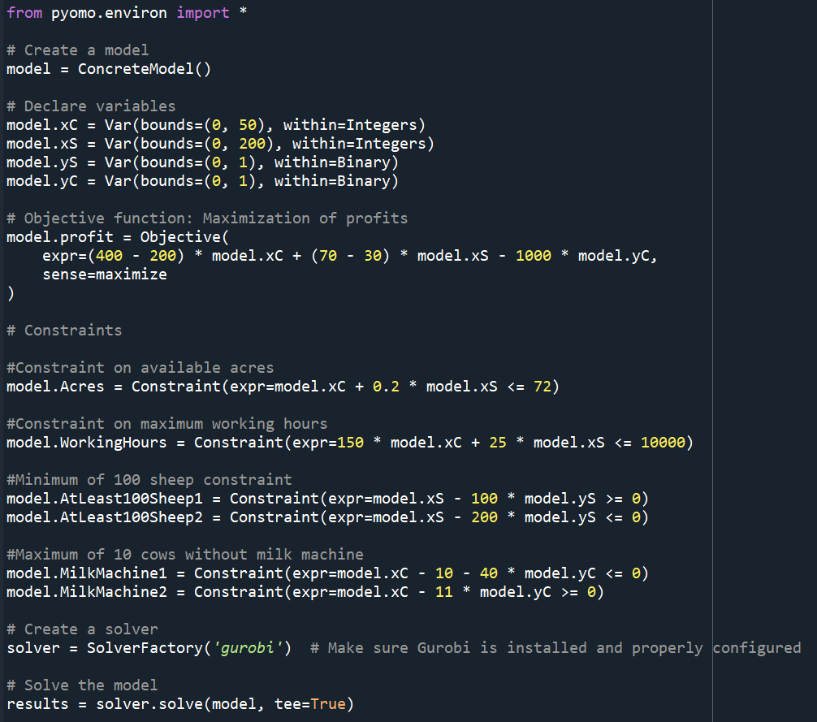
Pyomo Code
Carl.py

Slide 10
Plan
Task 0 : last week and at home
Today: Task 1 Building an evaluation framework for sequential decision-making methods
Weeks 3-4: Task 2 Stochastic Programming
Week 5: Assignment Work for Task 2 and Q&A
Weeks 6-7: Task 3 Approximate Dynamic Programming
Week 8: Assignment Work for Task 3 and Q&A
Weeks 9-11: Assignment B Robust Optimization
Weeks 12-13: Assignment Work for Assignment B, Q&A + extra material
Task 4 is about reporting the results from Tasks 2 and 3

Slide 11
The process of designing “Decision-making” frameworks
“Decisions”
Choosing a career path?
Deciding on which country to move next?
Stay in a relationship or not?
Define
Design
Validate

Slide 12
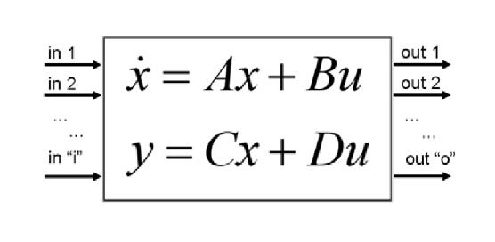
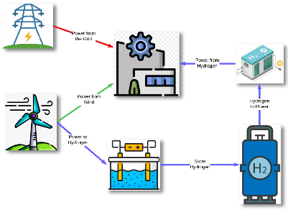

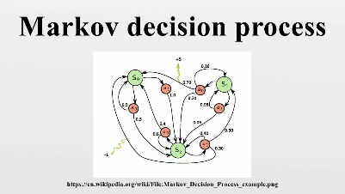
The process of designing “Decision-making” frameworks
“Decisions”
Choosing a career path?
Deciding on which country to move next?
Stay in a relationship or not?
Define
Design
Validate
Coding a simulation Environment to evaluate any decision-making policy

Slide 13
Agenda for today
Defining a problem of Sequential Decisions under Uncertainty
Examples
Coding an Evaluation Framework for the Assignment (Task 1)

Slide 14
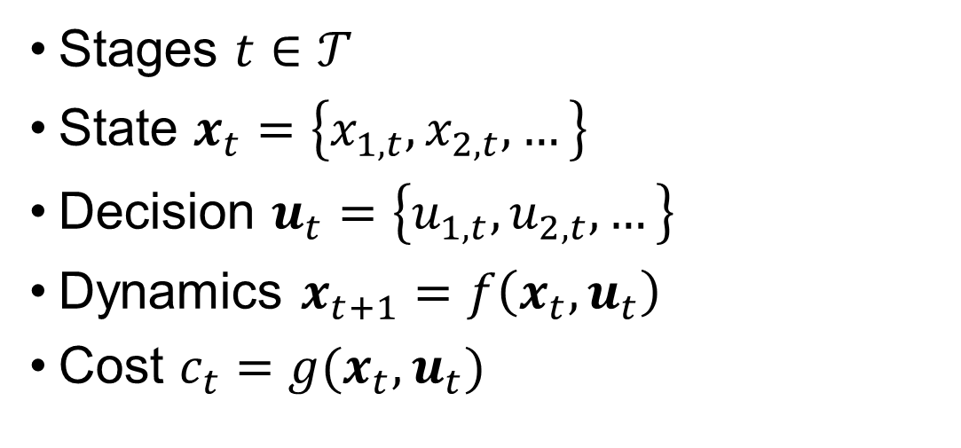
Markov Decision Process
Stages $t∈𝒯$
State $x_{t}=\left\{x_{1, t}, x_{2,t}, …\right\}$
Decision $u_{t}=\left\{u_{1, t}, u_{2,t}, …\right\}$
Dynamics $x_{t+1}=f\left(x_{t}, u_{t}\right)$
Cost $c_{t}=g(x_{t}, u_{t})$

Slide 15
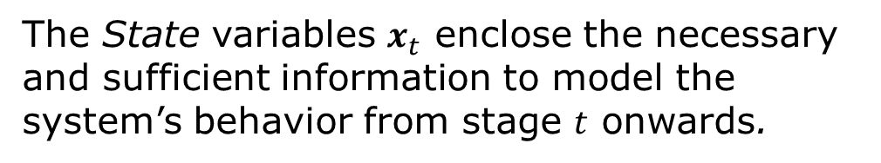
Markov Decision Process
Stages $t∈𝒯$
State $x_{t}=\left\{x_{1, t}, x_{2,t}, …\right\}$
Decision $u_{t}=\left\{u_{1, t}, u_{2,t}, …\right\}$
Dynamics $x_{t+1}=f\left(x_{t}, u_{t}\right)$
Cost $c_{t}=g(x_{t}, u_{t})$
The State variables $x_{t}$ enclose the necessary and sufficient information to model the system’s behavior from stage $t$ onwards.

Slide 16
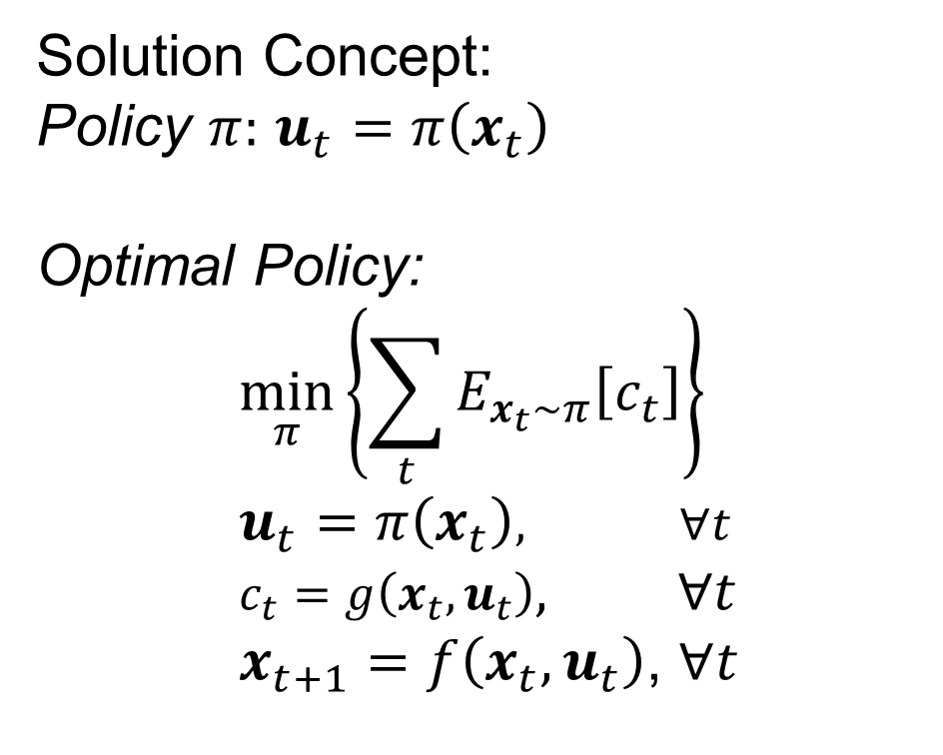
Markov Decision Process
Stages $t∈𝒯$
State $x_{t}=\left\{x_{1, t}, x_{2,t}, …\right\}$
Decision $u_{t}=\left\{u_{1, t}, u_{2,t}, …\right\}$
Dynamics $x_{t+1}=f\left(x_{t}, u_{t}\right)$
Cost $c_{t}=g(x_{t}, u_{t})$
Solution Concept:
Policy $π:$ $u_{t}=π\left(x_{t}\right)$
Optimal Policy:
$$\min_{π}\left\{\sum_{t}{E_{x_{t}\sim π}\left[c_{t}\right]}\right\} \\ u_{t}=π\left(x_{t}\right), ∀t \\ c_{t}=g\left(x_{t}, u_{t}\right), ∀t \\ x_{t+1}=f\left(x_{t}, u_{t}\right)\text{, }∀t$$
The State variables $x_{t}$ enclose the necessary and sufficient information to model the system’s behavior from stage $t$ onwards.

Slide 17
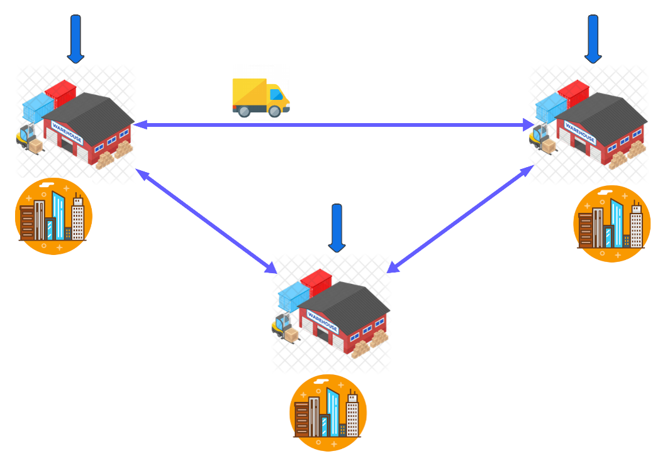
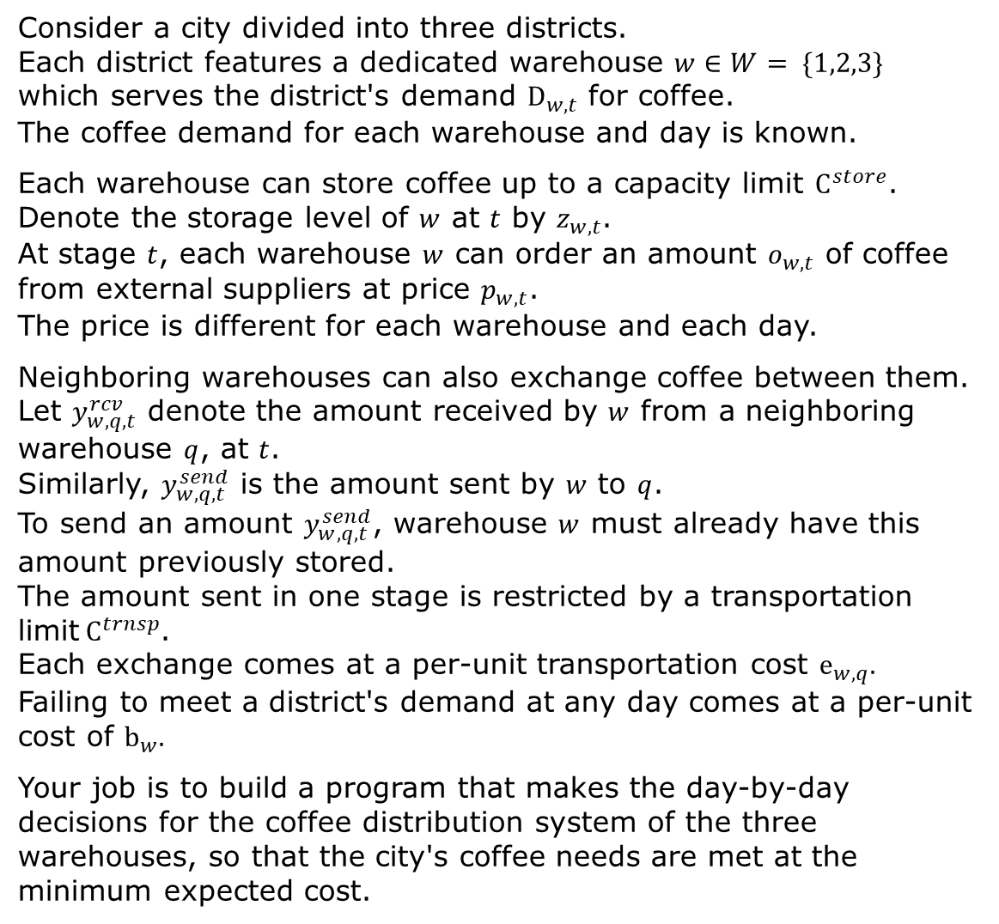
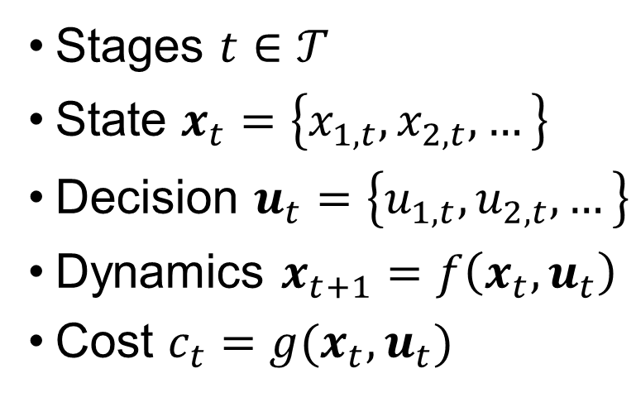
The Lead Example
Consider a city divided into three districts. Each district features a dedicated warehouse $w∈W= \{1,2,3\}$ which serves the district's demand $D_{w,t}$ for coffee. The coffee demand for each warehouse and day is known.
Each warehouse can store coffee up to a capacity limit $C^{store}$. Denote the storage level of $w$ at $t$ by $z_{w,t}$. At stage $t$, each warehouse $w$ can order an amount $o_{w,t}$ of coffee from external suppliers at price $p_{w,t}$. The price is different for each warehouse and each day.
Neighboring warehouses can also exchange coffee between them. Let $y_{w,q,t}^{rcv}$ denote the amount received by $w$ from a neighboring warehouse $q$, at $t$. Similarly, $y_{w,q,t}^{send}$ is the amount sent by $w$ to $q$. To send an amount $y_{w,q,t}^{send}$, warehouse $w$ must already have this amount previously stored. The amount sent in one stage is restricted by a transportation limit$C^{trnsp}$. Each exchange comes at a per-unit transportation cost $e_{w,q}.$ Failing to meet a district's demand at any day comes at a per-unit cost of $b_{w}.$
Your job is to build a program that makes the day-by-day decisions for the coffee distribution system of the three warehouses, so that the city's coffee needs are met at the minimum expected cost.
Stages $t∈𝒯$
State $x_{t}=\left\{x_{1, t}, x_{2,t}, …\right\}$
Decision $u_{t}=\left\{u_{1, t}, u_{2,t}, …\right\}$
Dynamics $x_{t+1}=f\left(x_{t}, u_{t}\right)$
Cost $c_{t}=g(x_{t}, u_{t})$

Slide 18
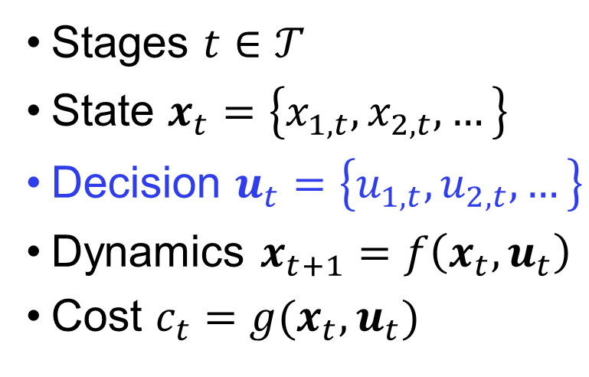
The Lead Example
Consider a city divided into three districts. Each district features a dedicated warehouse $w∈W= \{1,2,3\}$ which serves the district's demand $D_{w,t}$ for coffee. The coffee demand for each warehouse and day is known.
Each warehouse can store coffee up to a capacity limit $C^{store}$. Denote the storage level of $w$ at $t$ by $z_{w,t}$. At stage $t$, each warehouse $w$ can order an amount $o_{w,t}$ of coffee from external suppliers at price $p_{w,t}$. The price is different for each warehouse and each day.
Neighboring warehouses can also exchange coffee between them. Let $y_{w,q,t}^{rcv}$ denote the amount received by $w$ from a neighboring warehouse $q$, at $t$. Similarly, $y_{w,q,t}^{send}$ is the amount sent by $w$ to $q$. To send an amount $y_{w,q,t}^{send}$, warehouse $w$ must already have this amount previously stored. The amount sent in one stage is restricted by a transportation limit$C^{trnsp}$. Each exchange comes at a per-unit transportation cost $e_{w,q}.$ Failing to meet a district's demand at any day comes at a per-unit cost of $b_{w}.$
Your job is to build a program that makes the day-by-day decisions for the coffee distribution system of the three warehouses, so that the city's coffee needs are met at the minimum expected cost.
Stages $t∈𝒯$
State $x_{t}=\left\{x_{1, t}, x_{2,t}, …\right\}$
Decision $u_{t}=\left\{u_{1, t}, u_{2,t}, …\right\}$
Dynamics $x_{t+1}=f\left(x_{t}, u_{t}\right)$
Cost $c_{t}=g(x_{t}, u_{t})$

Slide 19
The Lead Example
Consider a city divided into three districts. Each district features a dedicated warehouse $w∈W= \{1,2,3\}$ which serves the district's demand $D_{w,t}$ for coffee. The coffee demand for each warehouse and day is known.
Each warehouse can store coffee up to a capacity limit $C^{store}$. Denote the storage level of $w$ at $t$ by $z_{w,t}$. At stage $t$, each warehouse $w$ can order an amount $o_{w,t}$ of coffee from external suppliers at price $p_{w,t}$. The price is different for each warehouse and each day.
Neighboring warehouses can also exchange coffee between them. Let $y_{w,q,t}^{rcv}$ denote the amount received by $w$ from a neighboring warehouse $q$, at $t$. Similarly, $y_{w,q,t}^{send}$ is the amount sent by $w$ to $q$. To send an amount $y_{w,q,t}^{send}$, warehouse $w$ must already have this amount previously stored. The amount sent in one stage is restricted by a transportation limit$C^{trnsp}$. Each exchange comes at a per-unit transportation cost $e_{w,q}.$ Failing to meet a district's demand at any day comes at a per-unit cost of $b_{w}.$
Your job is to build a program that makes the day-by-day decisions for the coffee distribution system of the three warehouses, so that the city's coffee needs are met at the minimum expected cost.
Stages $t∈𝒯$
State $x_{t}=\left\{x_{1, t}, x_{2,t}, …\right\}$
Decision $u_{t}=\left\{u_{1, t}, u_{2,t}, …\right\}$
Dynamics $x_{t+1}=f\left(x_{t}, u_{t}\right)$
Cost $c_{t}=g(x_{t}, u_{t})$

Slide 20
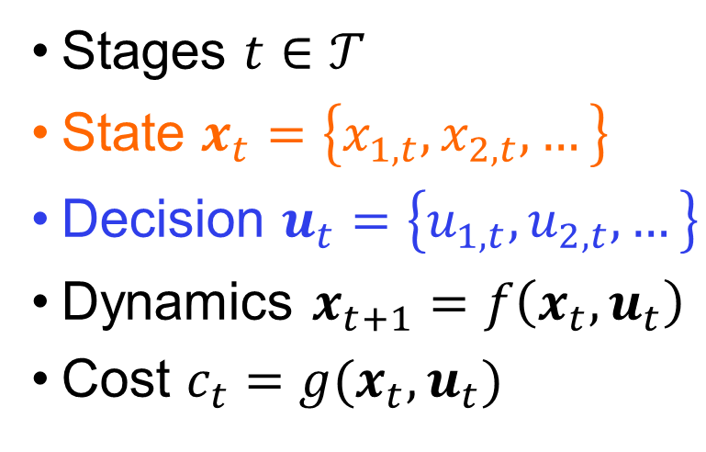
The Lead Example
Consider a city divided into three districts. Each district features a dedicated warehouse $w∈W= \{1,2,3\}$ which serves the district's demand $D_{w,t}$ for coffee. The coffee demand for each warehouse and day is known.
Each warehouse can store coffee up to a capacity limit $C^{store}$. Denote the storage level of $w$ at $t$ by $z_{w,t}$. At stage $t$, each warehouse $w$ can order an amount $o_{w,t}$ of coffee from external suppliers at price $p_{w,t}$. The price is different for each warehouse and each day.
Neighboring warehouses can also exchange coffee between them. Let $y_{w,q,t}^{rcv}$ denote the amount received by $w$ from a neighboring warehouse $q$, at $t$. Similarly, $y_{w,q,t}^{send}$ is the amount sent by $w$ to $q$. To send an amount $y_{w,q,t}^{send}$, warehouse $w$ must already have this amount previously stored. The amount sent in one stage is restricted by a transportation limit$C^{trnsp}$. Each exchange comes at a per-unit transportation cost $e_{w,q}.$ Failing to meet a district's demand at any day comes at a per-unit cost of $b_{w}.$
Your job is to build a program that makes the day-by-day decisions for the coffee distribution system of the three warehouses, so that the city's coffee needs are met at the minimum expected cost.
Stages $t∈𝒯$
State $x_{t}=\left\{x_{1, t}, x_{2,t}, …\right\}$
Decision $u_{t}=\left\{u_{1, t}, u_{2,t}, …\right\}$
Dynamics $x_{t+1}=f\left(x_{t}, u_{t}\right)$
Cost $c_{t}=g(x_{t}, u_{t})$

Slide 21
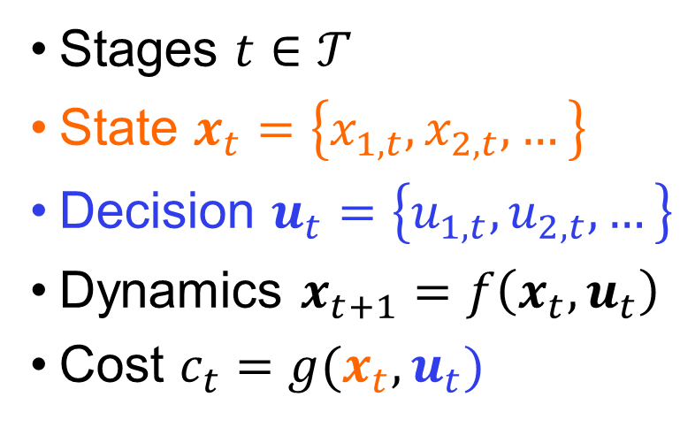
The Lead Example
Consider a city divided into three districts. Each district features a dedicated warehouse $w∈W= \{1,2,3\}$ which serves the district's demand $D_{w,t}$ for coffee. The coffee demand for each warehouse and day is known.
Each warehouse can store coffee up to a capacity limit $C^{store}$. Denote the storage level of $w$ at $t$ by $z_{w,t}$. At stage $t$, each warehouse $w$ can order an amount $o_{w,t}$ of coffee from external suppliers at price $p_{w,t}$. The price is different for each warehouse and each day.
Neighboring warehouses can also exchange coffee between them. Let $y_{w,q,t}^{rcv}$ denote the amount received by $w$ from a neighboring warehouse $q$, at $t$. Similarly, $y_{w,q,t}^{send}$ is the amount sent by $w$ to $q$. To send an amount $y_{w,q,t}^{send}$, warehouse $w$ must already have this amount previously stored. The amount sent in one stage is restricted by a transportation limit$C^{trnsp}$. Each exchange comes at a per-unit transportation cost $e_{w,q}.$ Failing to meet a district's demand at any day comes at a per-unit cost of $b_{w}.$
Your job is to build a program that makes the day-by-day decisions for the coffee distribution system of the three warehouses, so that the city's coffee needs are met at the minimum expected cost.
Stages $t∈𝒯$
State $x_{t}=\left\{x_{1, t}, x_{2,t}, …\right\}$
Decision $u_{t}=\left\{u_{1, t}, u_{2,t}, …\right\}$
Dynamics $x_{t+1}=f\left(x_{t}, u_{t}\right)$
Cost $c_{t}=g(x_{t}, u_{t})$

Slide 22
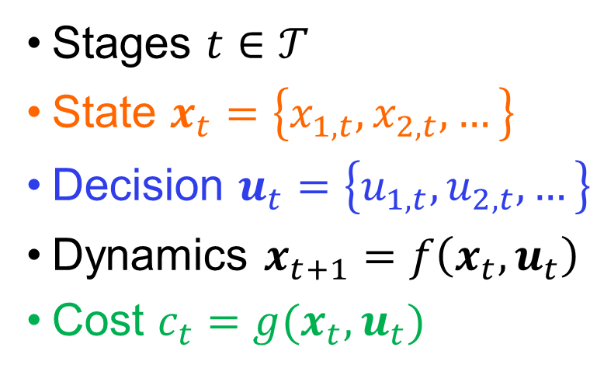
The Lead Example
Consider a city divided into three districts. Each district features a dedicated warehouse $w∈W= \{1,2,3\}$ which serves the district's demand $D_{w,t}$ for coffee. The coffee demand for each warehouse and day is known.
Each warehouse can store coffee up to a capacity limit $C^{store}$. Denote the storage level of $w$ at $t$ by $z_{w,t}$. At stage $t$, each warehouse $w$ can order an amount $o_{w,t}$ of coffee from external suppliers at price $p_{w,t}$. The price is different for each warehouse and each day.
Neighboring warehouses can also exchange coffee between them. Let $y_{w,q,t}^{rcv}$ denote the amount received by $w$ from a neighboring warehouse $q$, at $t$. Similarly, $y_{w,q,t}^{send}$ is the amount sent by $w$ to $q$. To send an amount $y_{w,q,t}^{send}$, warehouse $w$ must already have this amount previously stored. The amount sent in one stage is restricted by a transportation limit$C^{trnsp}$. Each exchange comes at a per-unit transportation cost $e_{w,q}.$ Failing to meet a district's demand at any day comes at a per-unit cost of $b_{w}.$
Your job is to build a program that makes the day-by-day decisions for the coffee distribution system of the three warehouses, so that the city's coffee needs are met at the minimum expected cost.
Stages $t∈𝒯$
State $x_{t}=\left\{x_{1, t}, x_{2,t}, …\right\}$
Decision $u_{t}=\left\{u_{1, t}, u_{2,t}, …\right\}$
Dynamics $x_{t+1}=f\left(x_{t}, u_{t}\right)$
Cost $c_{t}=g(x_{t}, u_{t})$

Slide 23

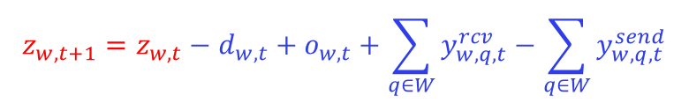
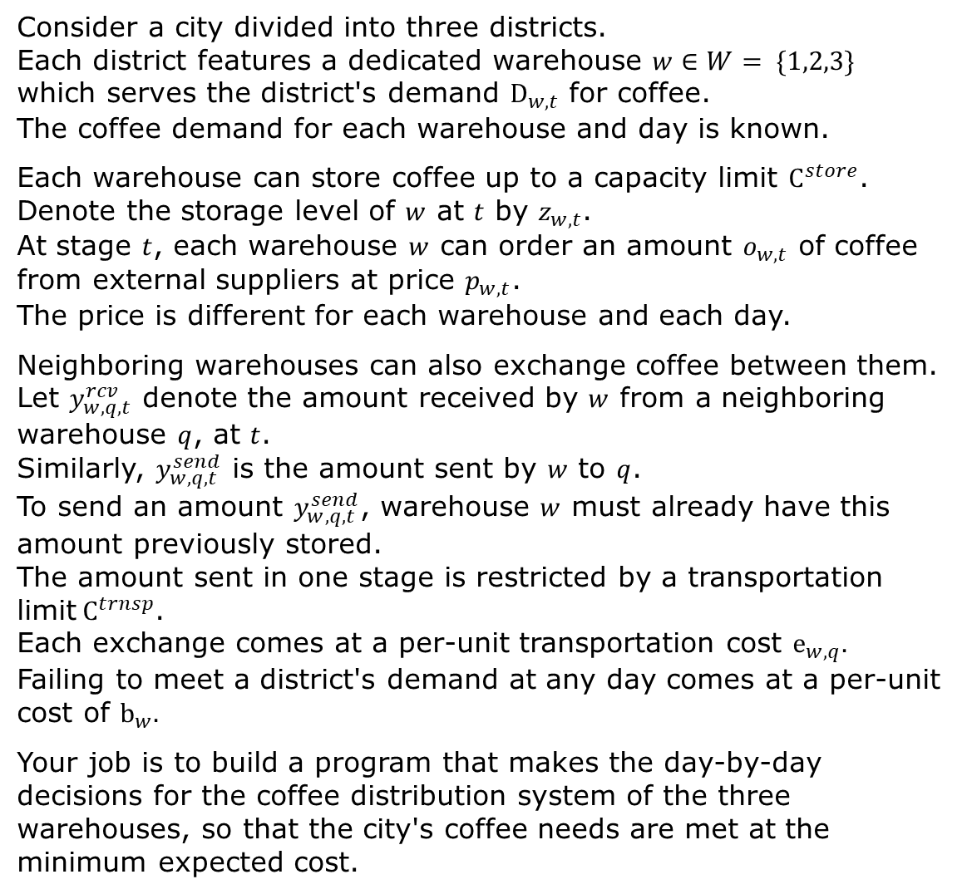
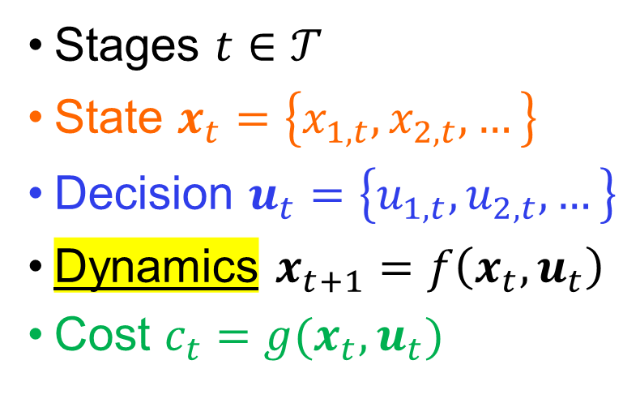
The Lead Example
Consider a city divided into three districts. Each district features a dedicated warehouse $w∈W= \{1,2,3\}$ which serves the district's demand $D_{w,t}$ for coffee. The coffee demand for each warehouse and day is known.
Each warehouse can store coffee up to a capacity limit $C^{store}$. Denote the storage level of $w$ at $t$ by $z_{w,t}$. At stage $t$, each warehouse $w$ can order an amount $o_{w,t}$ of coffee from external suppliers at price $p_{w,t}$. The price is different for each warehouse and each day.
Neighboring warehouses can also exchange coffee between them. Let $y_{w,q,t}^{rcv}$ denote the amount received by $w$ from a neighboring warehouse $q$, at $t$. Similarly, $y_{w,q,t}^{send}$ is the amount sent by $w$ to $q$. To send an amount $y_{w,q,t}^{send}$, warehouse $w$ must already have this amount previously stored. The amount sent in one stage is restricted by a transportation limit$C^{trnsp}$. Each exchange comes at a per-unit transportation cost $e_{w,q}.$ Failing to meet a district's demand at any day comes at a per-unit cost of $b_{w}.$
Your job is to build a program that makes the day-by-day decisions for the coffee distribution system of the three warehouses, so that the city's coffee needs are met at the minimum expected cost.
$$z_{w,t+1}=z_{w,t}−d_{w,t}+o_{w,t}+\sum_{q∈W}{y_{w,q,t}^{rcv}}−\sum_{q∈W}{y_{w,q,t}^{send}}$$
Stages $t∈𝒯$
State $x_{t}=\left\{x_{1, t}, x_{2,t}, …\right\}$
Decision $u_{t}=\left\{u_{1, t}, u_{2,t}, …\right\}$
Dynamics $x_{t+1}=f\left(x_{t}, u_{t}\right)$
Cost $c_{t}=g(x_{t}, u_{t})$
$$d_{w,t}$$

Slide 24
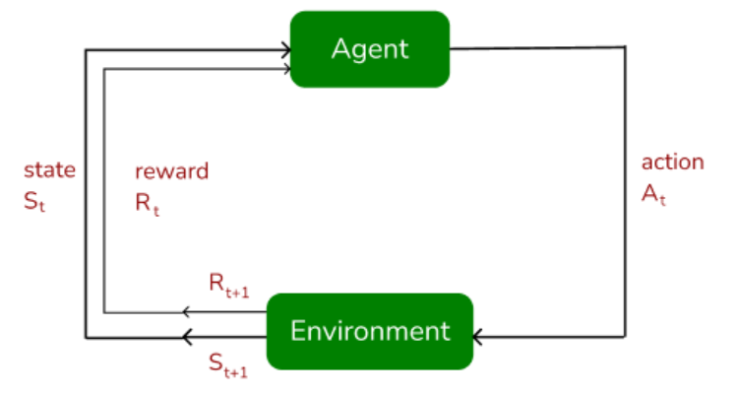
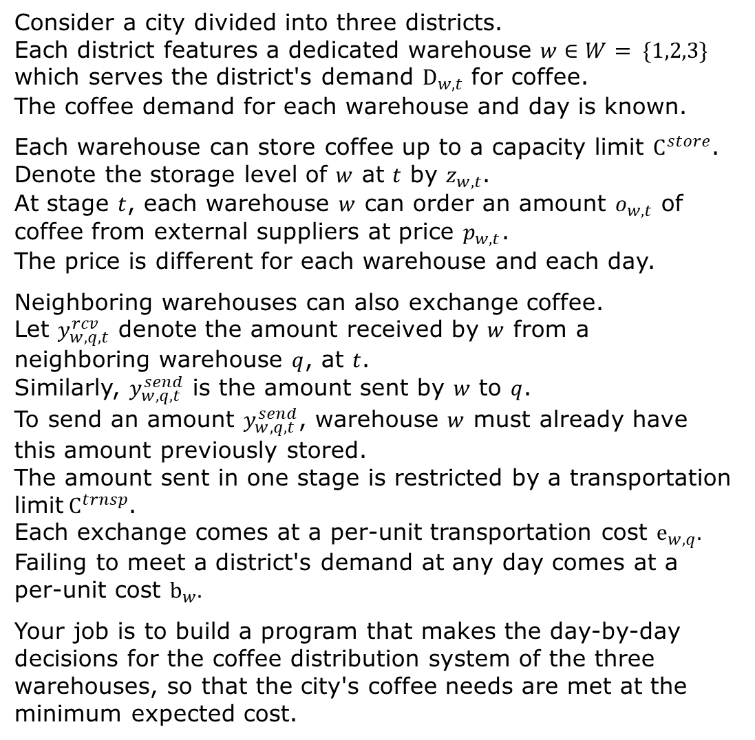
Simulation Environment
Consider a city divided into three districts. Each district features a dedicated warehouse $w∈W= \{1,2,3\}$ which serves the district's demand $D_{w,t}$ for coffee. The coffee demand for each warehouse and day is known.
Each warehouse can store coffee up to a capacity limit $C^{store}$. Denote the storage level of $w$ at $t$ by $z_{w,t}$. At stage $t$, each warehouse $w$ can order an amount $o_{w,t}$ of coffee from external suppliers at price $p_{w,t}$. The price is different for each warehouse and each day.
Neighboring warehouses can also exchange coffee. Let $y_{w,q,t}^{rcv}$ denote the amount received by $w$ from a neighboring warehouse $q$, at $t$. Similarly, $y_{w,q,t}^{send}$ is the amount sent by $w$ to $q$. To send an amount $y_{w,q,t}^{send}$, warehouse $w$ must already have this amount previously stored. The amount sent in one stage is restricted by a transportation limit$C^{trnsp}$. Each exchange comes at a per-unit transportation cost $e_{w,q}.$ Failing to meet a district's demand at any day comes at a per-unit cost $b_{w}.$
Your job is to build a program that makes the day-by-day decisions for the coffee distribution system of the three warehouses, so that the city's coffee needs are met at the minimum expected cost.

Slide 25
Simulation Environment
Consider a city divided into three districts. Each district features a dedicated warehouse $w∈W= \{1,2,3\}$ which serves the district's demand $D_{w,t}$ for coffee. The coffee demand for each warehouse and day is known.
Each warehouse can store coffee up to a capacity limit $C^{store}$. Denote the storage level of $w$ at $t$ by $z_{w,t}$. At stage $t$, each warehouse $w$ can order an amount $o_{w,t}$ of coffee from external suppliers at price $p_{w,t}$. The price is different for each warehouse and each day.
Neighboring warehouses can also exchange coffee. Let $y_{w,q,t}^{rcv}$ denote the amount received by $w$ from a neighboring warehouse $q$, at $t$. Similarly, $y_{w,q,t}^{send}$ is the amount sent by $w$ to $q$. To send an amount $y_{w,q,t}^{send}$, warehouse $w$ must already have this amount previously stored. The amount sent in one stage is restricted by a transportation limit$C^{trnsp}$. Each exchange comes at a per-unit transportation cost $e_{w,q}.$ Failing to meet a district's demand at any day comes at a per-unit cost $b_{w}.$
Your job is to build a program that makes the day-by-day decisions for the coffee distribution system of the three warehouses, so that the city's coffee needs are met at the minimum expected cost.

Slide 26

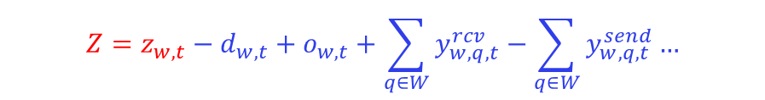
Simulation Environment
Consider a city divided into three districts. Each district features a dedicated warehouse $w∈W= \{1,2,3\}$ which serves the district's demand $D_{w,t}$ for coffee. The coffee demand for each warehouse and day is known.
Each warehouse can store coffee up to a capacity limit $C^{store}$. Denote the storage level of $w$ at $t$ by $z_{w,t}$. At stage $t$, each warehouse $w$ can order an amount $o_{w,t}$ of coffee from external suppliers at price $p_{w,t}$. The price is different for each warehouse and each day.
Neighboring warehouses can also exchange coffee. Let $y_{w,q,t}^{rcv}$ denote the amount received by $w$ from a neighboring warehouse $q$, at $t$. Similarly, $y_{w,q,t}^{send}$ is the amount sent by $w$ to $q$. To send an amount $y_{w,q,t}^{send}$, warehouse $w$ must already have this amount previously stored. The amount sent in one stage is restricted by a transportation limit$C^{trnsp}$. Each exchange comes at a per-unit transportation cost $e_{w,q}.$ Failing to meet a district's demand at any day comes at a per-unit cost $b_{w}.$
Your job is to build a program that makes the day-by-day decisions for the coffee distribution system of the three warehouses, so that the city's coffee needs are met at the minimum expected cost.
$$Z=z_{w,t}−d_{w,t}+o_{w,t}+\sum_{q∈W}{y_{w,q,t}^{rcv}}−\sum_{q∈W}{y_{w,q,t}^{send}}…$$
if $Z> C^{store}:$ then $z_{w, t+1}=C^{store}$ if $Z<0:$ then $z_{w, t+1}=0$, $d_{w,t}=d_{w,t}−|Z|$ else: $z_{w, t+1}=Z$

Slide 27
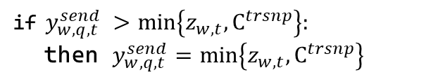
Simulation Environment
Consider a city divided into three districts. Each district features a dedicated warehouse $w∈W= \{1,2,3\}$ which serves the district's demand $D_{w,t}$ for coffee. The coffee demand for each warehouse and day is known.
Each warehouse can store coffee up to a capacity limit $C^{store}$. Denote the storage level of $w$ at $t$ by $z_{w,t}$. At stage $t$, each warehouse $w$ can order an amount $o_{w,t}$ of coffee from external suppliers at price $p_{w,t}$. The price is different for each warehouse and each day.
Neighboring warehouses can also exchange coffee. Let $y_{w,q,t}^{rcv}$ denote the amount received by $w$ from a neighboring warehouse $q$, at $t$. Similarly, $y_{w,q,t}^{send}$ is the amount sent by $w$ to $q$. To send an amount $y_{w,q,t}^{send}$, warehouse $w$ must already have this amount previously stored. The amount sent in one stage is restricted by a transportation limit$C^{trnsp}$. Each exchange comes at a per-unit transportation cost $e_{w,q}.$ Failing to meet a district's demand at any day comes at a per-unit cost $b_{w}.$
Your job is to build a program that makes the day-by-day decisions for the coffee distribution system of the three warehouses, so that the city's coffee needs are met at the minimum expected cost.
$$Z=z_{w,t}−d_{w,t}+o_{w,t}+\sum_{q∈W}{y_{w,q,t}^{rcv}}−\sum_{q∈W}{y_{w,q,t}^{send}}…$$
if $Z> C^{store}:$ then $z_{w, t+1}=C^{store}$ if $Z<0:$ then $z_{w, t+1}=0$, $d_{w,t}=d_{w,t}−|Z|$ else: $z_{w, t+1}=Z$
if $y_{w,q,t}^{send} >min\left\{z_{w,t}, C^{trsnp}\right\}:$ then $y_{w,q,t}^{send}=min\left\{z_{w,t}, C^{trsnp}\right\}$

Slide 28
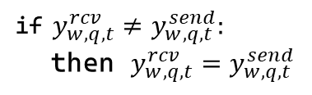
Simulation Environment
Consider a city divided into three districts. Each district features a dedicated warehouse $w∈W= \{1,2,3\}$ which serves the district's demand $D_{w,t}$ for coffee. The coffee demand for each warehouse and day is known.
Each warehouse can store coffee up to a capacity limit $C^{store}$. Denote the storage level of $w$ at $t$ by $z_{w,t}$. At stage $t$, each warehouse $w$ can order an amount $o_{w,t}$ of coffee from external suppliers at price $p_{w,t}$. The price is different for each warehouse and each day.
Neighboring warehouses can also exchange coffee. Let $y_{w,q,t}^{rcv}$ denote the amount received by $w$ from a neighboring warehouse $q$, at $t$. Similarly, $y_{w,q,t}^{send}$ is the amount sent by $w$ to $q$. To send an amount $y_{w,q,t}^{send}$, warehouse $w$ must already have this amount previously stored. The amount sent in one stage is restricted by a transportation limit$C^{trnsp}$. Each exchange comes at a per-unit transportation cost $e_{w,q}.$ Failing to meet a district's demand at any day comes at a per-unit cost $b_{w}.$
Your job is to build a program that makes the day-by-day decisions for the coffee distribution system of the three warehouses, so that the city's coffee needs are met at the minimum expected cost.
$$Z=z_{w,t}−d_{w,t}+o_{w,t}+\sum_{q∈W}{y_{w,q,t}^{rcv}}−\sum_{q∈W}{y_{w,q,t}^{send}}…$$
if $Z> C^{store}:$ then $z_{w, t+1}=C^{store}$ if $Z<0:$ then $z_{w, t+1}=0$, $d_{w,t}=d_{w,t}−|Z|$ else: $z_{w, t+1}=Z$
if $y_{w,q,t}^{send} >min\left\{z_{w,t}, C^{trsnp}\right\}:$ then $y_{w,q,t}^{send}=min\left\{z_{w,t}, C^{trsnp}\right\}$
if $y_{w,q,t}^{rcv}≠y_{w,q,t}^{send}:$ then $y_{w,q,t}^{rcv}=y_{w,q,t}^{send}$

Slide 29
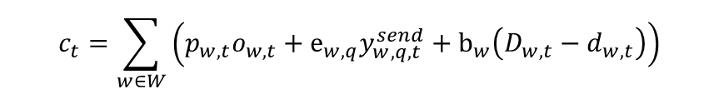
Simulation Environment
Consider a city divided into three districts. Each district features a dedicated warehouse $w∈W= \{1,2,3\}$ which serves the district's demand $D_{w,t}$ for coffee. The coffee demand for each warehouse and day is known.
Each warehouse can store coffee up to a capacity limit $C^{store}$. Denote the storage level of $w$ at $t$ by $z_{w,t}$. At stage $t$, each warehouse $w$ can order an amount $o_{w,t}$ of coffee from external suppliers at price $p_{w,t}$. The price is different for each warehouse and each day.
Neighboring warehouses can also exchange coffee. Let $y_{w,q,t}^{rcv}$ denote the amount received by $w$ from a neighboring warehouse $q$, at $t$. Similarly, $y_{w,q,t}^{send}$ is the amount sent by $w$ to $q$. To send an amount $y_{w,q,t}^{send}$, warehouse $w$ must already have this amount previously stored. The amount sent in one stage is restricted by a transportation limit$C^{trnsp}$. Each exchange comes at a per-unit transportation cost $e_{w,q}.$ Failing to meet a district's demand at any day comes at a per-unit cost $b_{w}.$
Your job is to build a program that makes the day-by-day decisions for the coffee distribution system of the three warehouses, so that the city's coffee needs are met at the minimum expected cost.
$$c_{t}=\sum_{w∈W}{\left(p_{w,t}o_{w,t}+e_{w,q}y_{w,q,t}^{send}+b_{w}\left(D_{w,t}−d_{w,t}\right)\right)}$$
$$Z=z_{w,t}−d_{w,t}+o_{w,t}+\sum_{q∈W}{y_{w,q,t}^{rcv}}−\sum_{q∈W}{y_{w,q,t}^{send}}…$$
if $Z> C^{store}:$ then $z_{w, t+1}=C^{store}$ if $Z<0:$ then $z_{w, t+1}=0$, $d_{w,t}=d_{w,t}−|Z|$ else: $z_{w, t+1}=Z$
if $y_{w,q,t}^{send} >min\left\{z_{w,t}, C^{trsnp}\right\}:$ then $y_{w,q,t}^{send}=min\left\{z_{w,t}, C^{trsnp}\right\}$
if $y_{w,q,t}^{rcv}≠y_{w,q,t}^{send}:$ then $y_{w,q,t}^{rcv}=y_{w,q,t}^{send}$

Slide 30

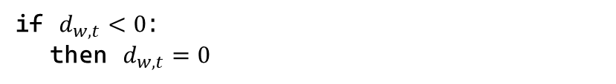
Simulation Environment
Consider a city divided into three districts. Each district features a dedicated warehouse $w∈W= \{1,2,3\}$ which serves the district's demand $D_{w,t}$ for coffee. The coffee demand for each warehouse and day is known.
Each warehouse can store coffee up to a capacity limit $C^{store}$. Denote the storage level of $w$ at $t$ by $z_{w,t}$. At stage $t$, each warehouse $w$ can order an amount $o_{w,t}$ of coffee from external suppliers at price $p_{w,t}$. The price is different for each warehouse and each day.
Neighboring warehouses can also exchange coffee. Let $y_{w,q,t}^{rcv}$ denote the amount received by $w$ from a neighboring warehouse $q$, at $t$. Similarly, $y_{w,q,t}^{send}$ is the amount sent by $w$ to $q$. To send an amount $y_{w,q,t}^{send}$, warehouse $w$ must already have this amount previously stored. The amount sent in one stage is restricted by a transportation limit$C^{trnsp}$. Each exchange comes at a per-unit transportation cost $e_{w,q}.$ Failing to meet a district's demand at any day comes at a per-unit cost $b_{w}.$
Your job is to build a program that makes the day-by-day decisions for the coffee distribution system of the three warehouses, so that the city's coffee needs are met at the minimum expected cost.
$$c_{t}=\sum_{w∈W}{\left(p_{w,t}o_{w,t}+e_{w,q}y_{w,q,t}^{send}+b_{w}\left(D_{w,t}−d_{w,t}\right)\right)}$$
if $d_{w,t}<0$: then $d_{w,t}=0$
$$Z=z_{w,t}−d_{w,t}+o_{w,t}+\sum_{q∈W}{y_{w,q,t}^{rcv}}−\sum_{q∈W}{y_{w,q,t}^{send}}…$$
if $Z> C^{store}:$ then $z_{w, t+1}=C^{store}$ if $Z<0:$ then $z_{w, t+1}=0$, $d_{w,t}=d_{w,t}−|Z|$ else: $z_{w, t+1}=Z$
if $y_{w,q,t}^{send} >min\left\{z_{w,t}, C^{trsnp}\right\}:$ then $y_{w,q,t}^{send}=min\left\{z_{w,t}, C^{trsnp}\right\}$
$$d_{w,t}$$
if $y_{w,q,t}^{rcv}≠y_{w,q,t}^{send}:$ then $y_{w,q,t}^{rcv}=y_{w,q,t}^{send}$

Slide 31
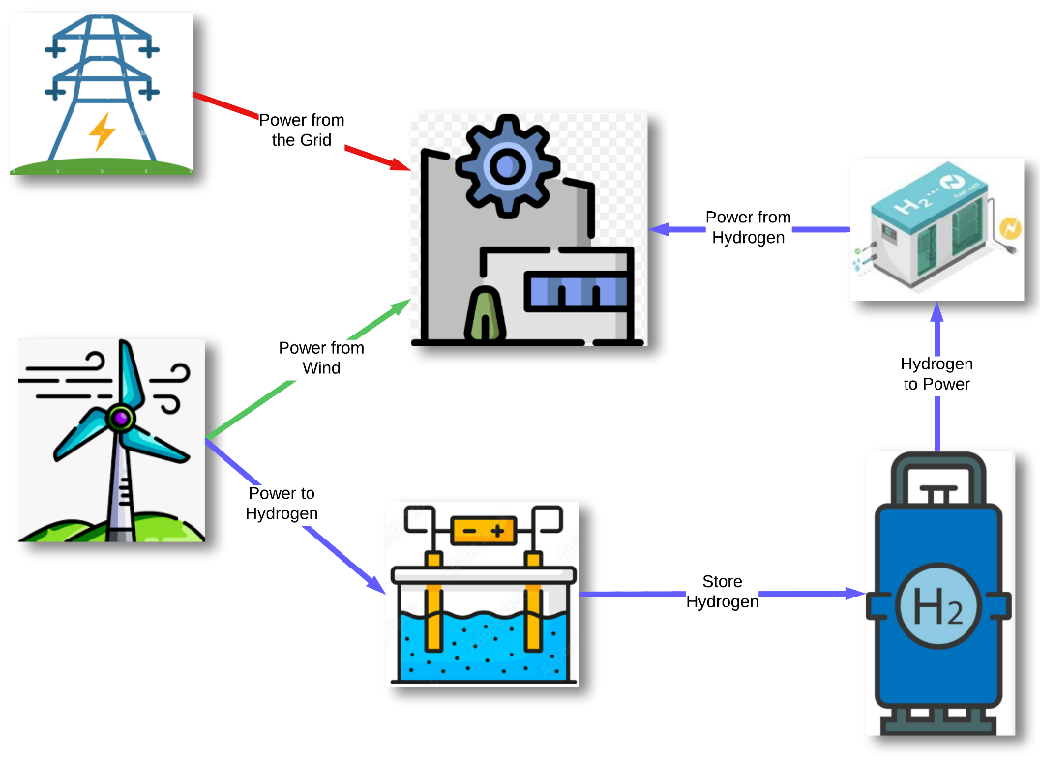
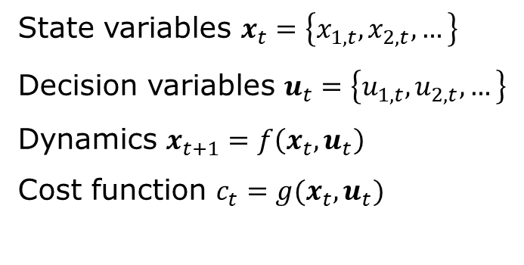
Assignment A, Task 1
Deliverable 1: MDP
State variables $x_{t}=\left\{x_{1, t}, x_{2,t}, …\right\}$
Decision variables $u_{t}=\left\{u_{1, t}, u_{2,t}, …\right\}$
Dynamics $x_{t+1}=f\left(x_{t}, u_{t}\right)$
Cost function $c_{t}=g(x_{t}, u_{t})$
Deliverable 2: Policy Evaluation Framework
Input: policy (python function that returns decisions) Initialize state variables For experiment 1 to E: For stage 1 to H: decisions = policy(state) check/correct decisions if inconsistent calculate cost for this stage and experiment calculate state at next stage calculate total cost of policy for this experiment Return: expected policy cost (average over experiments)

Slide 32
Questions and Survey
- Group selection is open until Friday

